Slide 1

Atal Bihari Vajpayee-
Indian Institute of Information Technology and Management Gwalior
Computer Graphics Lab : 07
Spline-based Object Representation
Instructor – Dr. Sunil Kumar
Assistant Professor @ Dept. of Information Technology, ABV-IIITM Gwalior
Teaching Assistants (TAs)
Mehr Aliah, Sheel Patel, Aditya | Group-02
Anushka Agarwal, Abhishek Shrivastav, Radhika Gupta, Pranav | Group-01

Slide 2
Objective of this lab
The objective of this lab is to represent and approximate 2D object boundaries using spline curves. The lab involves selecting control points and studying first-order, second-order, and third-order splines for smooth and accurate object representation.

Slide 3
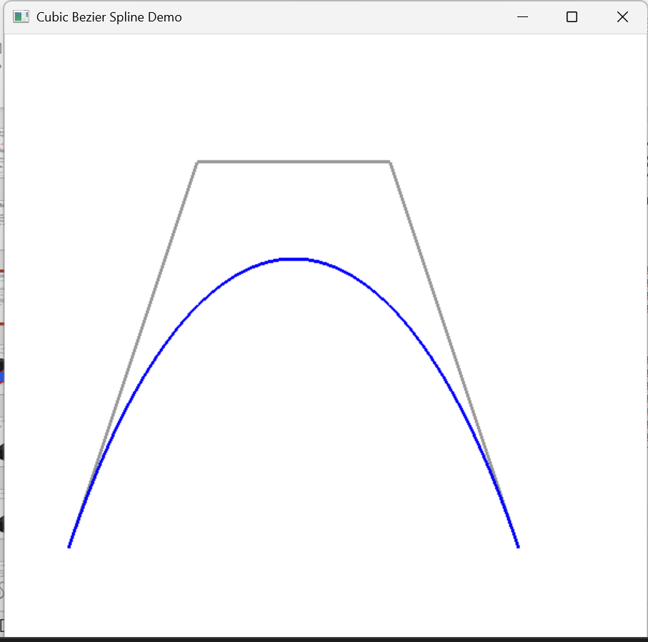
Demo Assignment – 01
Draw a cubic Bézier spline curve using four control points and display the resulting curve on the computer screen using OpenGL.
#include <GL/freeglut.h>
void display()
{
glClear(GL_COLOR_BUFFER_BIT);
float x0 = 1.0f, y0 = 2.0f;
float x1 = 3.0f, y1 = 8.0f;
float x2 = 6.0f, y2 = 8.0f;
float x3 = 8.0f, y3 = 2.0f;
// Control polygon
glColor3f(0.6f, 0.6f, 0.6f);
glBegin(GL_LINE_STRIP);
glVertex2f(x0, y0);
glVertex2f(x1, y1);
glVertex2f(x2, y2);
glVertex2f(x3, y3);
glEnd();
// Cubic Bezier curve
glColor3f(0.0f, 0.0f, 1.0f);
glLineWidth(3.0f);
glBegin(GL_LINE_STRIP);
for (int i = 0; i <= 100; i++)
{
float t = i / 100.0f;
float u = 1.0f - t;
float x = u*u*u*x0
+ 3*u*u*t*x1
+ 3*u*t*t*x2
+ t*t*t*x3;
float y = u*u*u*y0
+ 3*u*u*t*y1
+ 3*u*t*t*y2
+ t*t*t*y3;
glVertex2f(x, y);
}
glEnd();
glFlush();
}
void init()
{
glClearColor(1.0f, 1.0f, 1.0f, 1.0f);
glMatrixMode(GL_PROJECTION);
glLoadIdentity();
glOrtho(0, 10, 0, 10, -1, 1);
}
int main(int argc, char** argv)
{
glutInit(&argc, argv);
glutInitDisplayMode(GLUT_SINGLE | GLUT_RGB);
glutInitWindowSize(600, 600);
glutCreateWindow("Cubic Bezier Spline Demo");
init();
glutDisplayFunc(display);
glutMainLoop();
return 0;
}

Slide 4
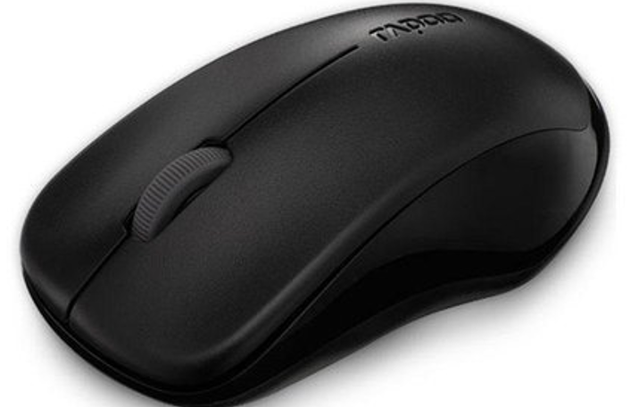
Assignment - 02
Question -02 : Using OpenGL, localize 3D control points on the object shown below.

Slide 5
Assignment - 03
Question -03 : Approximate the boundary using:
  First order spline
  2nd Order spline
  3rd order spline

Slide 6
Assignment - 04
Question -04 : Generate 1000 control points and draw the boundary again using:
  First order spline
  2nd Order spline
  3rd order spline

Slide 7



Assignment - 05
Question -05 : Indicate suitable (set of control points) no. of control points (say N) on below objects and approximate them using 3rd order spline.
Question -06: Generate another N no of control points and repeat the experiment.
(a)
(b)
(c)

Slide 8
Thank you !

